Slide 2
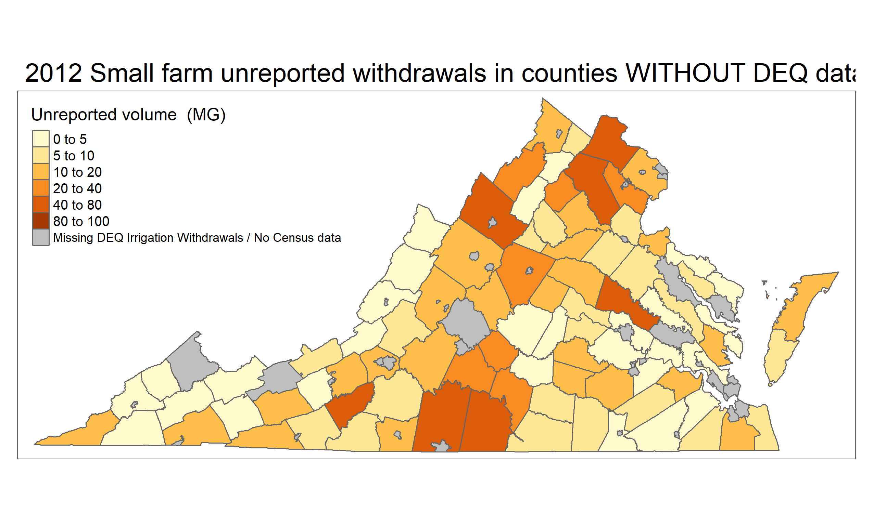
2012 Small farm unreported withdrawals

Slide 3
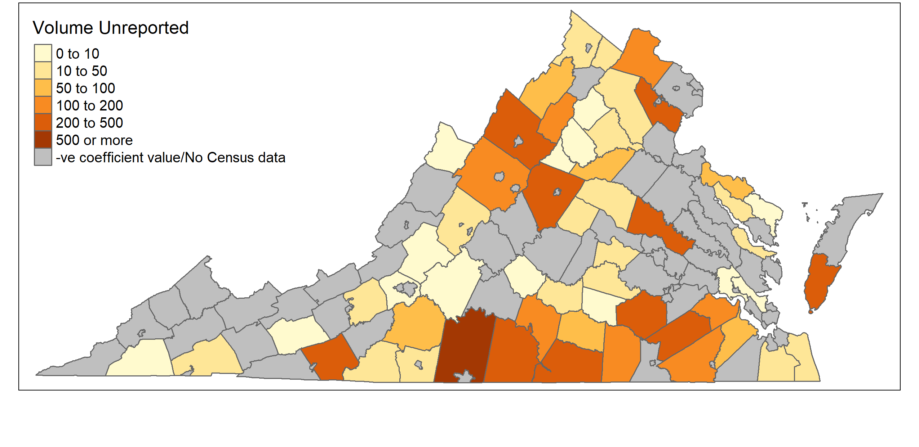
2012 Large farm unreported withdrawals

